Slide 1
Gesture Recognition Based Intelligent
Human-Computer-Interaction Mobile Robot Design
Members：赖鹏楠、童年、杨寒梅 、黄珂邈、田闰心、林森

Slide 2
1
Background and Motivation

Slide 3

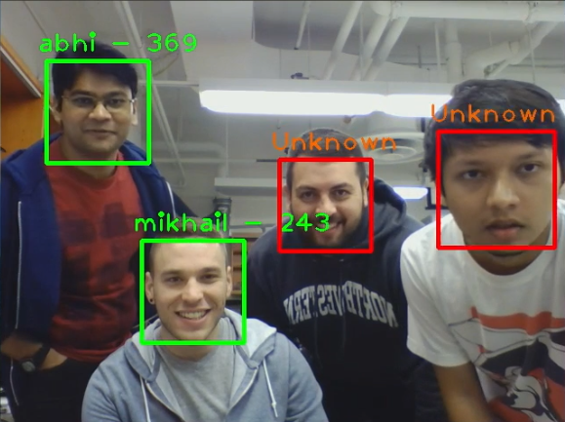
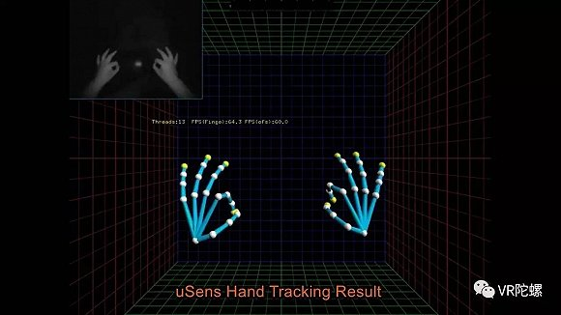
01
Background
Gesture recognition
Face recognition
Glove-Based Approach
Hinders the ease and naturalness of the user interaction in computer controlled environment.
Vision-Based Approach
More User-friendly and does not require any extra devices on the user. Provides a natural way of user interaction and some more properties such as texture and color for analyzing gesture.
Lots of challenges
Accuracy can beyond 99.80% by Tencent best CV team.
Research Tendency
Deep learning
Face Tracking
Tracking Learning Detection by Zdenek Kalal
Stable, reliable and robust algorithm.
1
2

Slide 4
01
Challenges
Human-Computer-Interaction Challenges
1. Gesture Recognition
Tracking Accuracy
Feature Complexity
Target Occlusion
Track & locate the target
Larger scale rotation
Difficult to extract features
Difficult to train the model
Hard to detect accurately
Influence the recognition accuracy
2. Face Recognition
Uncertain Environment
Feature Complexity
Identification Accuracy
Low illumination
Different expressions & poses
Many faces in one picture
3. Motion Control
Uncertain Environment
Collision Avoidance
Movement Combination

Slide 5
2
Related Work & Novelty

Slide 6
02
Related Work
Research on gesture recognition

Slide 7
02
Novelty
Recognition
Add more constrains
Combine RGB, light flow, depth features.
 | Proposed Year | Pros | Cons
HMM-NN Algorithm | 2013 | Relative better result Low computation cost | Influence by environments
3D CNN | 2015 | Accurate Result Process time and space features simultaneously | Dependent
SIFT Algorithm | 2017 | Robustness | Hard to construct model

Slide 8
02
Novelty
Tracking
Extract and optimize feature points
Structure of cascade detectors
Track on certain person ( Support by face detection and gesture verification)
 | Proposed Year | Pros | Cons
Skin Color Model | Tradition method | Simple Computation cost low | Low accuracy Dependent
Kalman Filter Algorithm | 2015 | Accurate Position Prediction | Fail when large scale rotation
Vibe Algorithm | 2018 | No initial parameter | Computation cost high

Slide 9
3
Problem Statement & System Setup

Slide 10
03
Problem Statement
This work resolves the following problems specifically.
How to track the gestures of specific host correctly.
How to recognize face correctly.
How to track the recognized face and neglect other faces.
How to combine different movements together with the gesture commands.

Slide 11
03
Improved System
Successful?
Target
Detection
Training
Collection
Face Detection
Recognition
Execution
Detection
Extract
Features
Extraction
Prediction
Successful?
Detection & Tracking
Classification
Robot Control

Slide 12
4
Proposed Design & Methods

Slide 13

04
Gesture Recognition
Dynamic gesture interaction based on millimeter wave radar or depth camera
Mask Area
Inputs
Absolute Position
Profile
Variation
Curve Fitting
Training
Relative Position
Positioning
$T = \sum{w_{i}(d_{input}−d_{truth}) }$

Slide 14
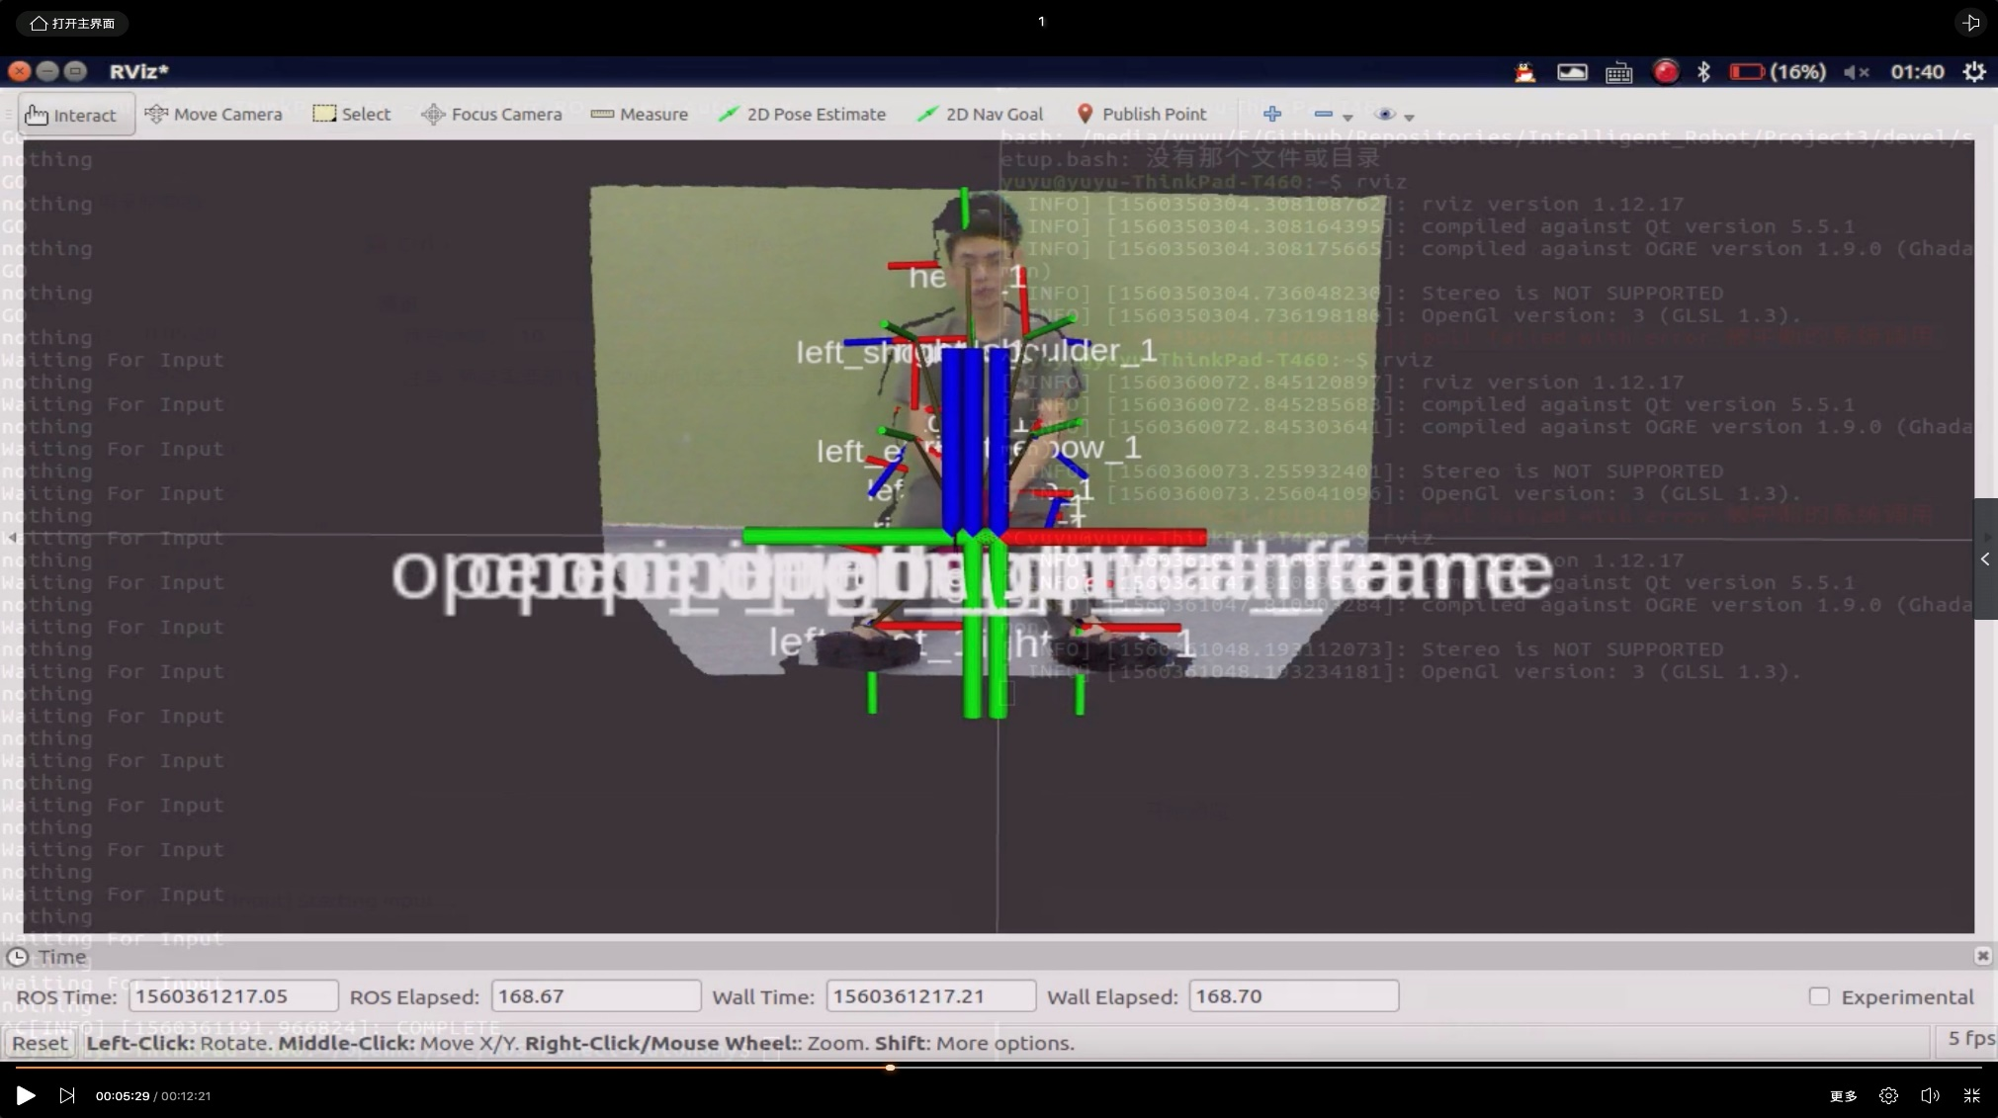
04
Gesture Recognition
Dynamic gesture interaction based on millimeter wave radar or depth camera

Slide 15
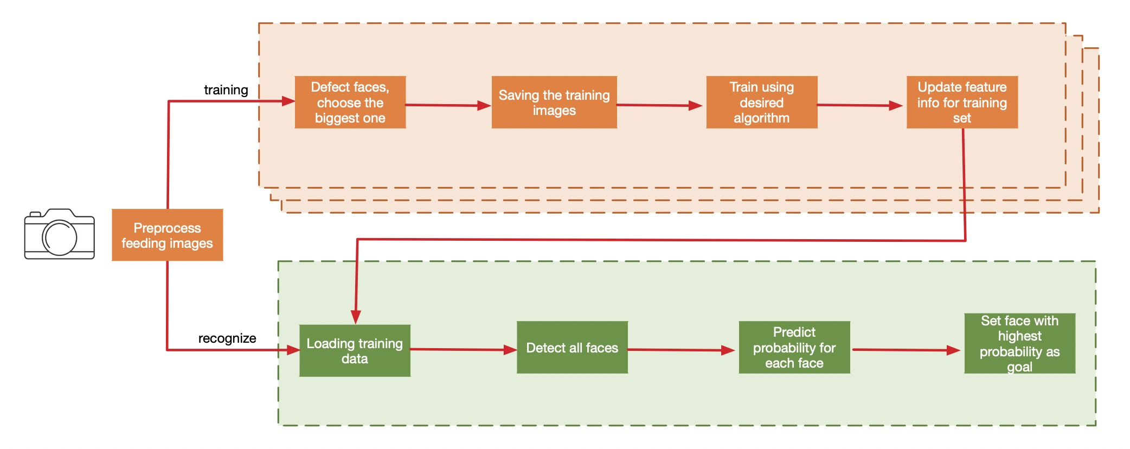
04
Face Recognition
Use a webcam, OpenCV and ROS, develop an API to recognize faces in real-time

Slide 16
04
Motion Control
Independent Node
Inter-Node Communication
Encapsulate Movements
Movements
Subscribe(‘Commander’);
Publisher('cmd_vel_mux/input/navi', Twist, queue_size=10);
Move; // Encapsulate Object
While(True):
Waiting_For_Command()
Move()
def Move():
for move.time:
if detect_Collision()
publish(stop)
break
publish(move.movement)
sleep(5hz);
Commander(Main)
While(True):
Recognize_Face_and_Gesture();
Publish(cmd_msg);

Slide 17
5
Hardware & Software Platform

Slide 18
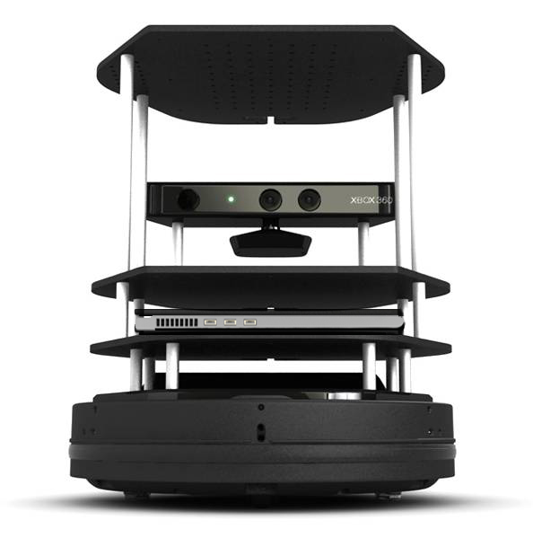
05
Hardware & Software
ROS & gazebo
ROS platform is used for communication between different nodes. Gazebo is used for simulation. All the code is written in Python.
OpenNI
The OpenNI framework provides a set of open source APIs. Depth map, BGR image and some other formats of output can be retrieved by using familiar interface of ”VideoCapture”.
OpenCV
OpenCV library for image processing, target tracking and classification.
NumPy
Scientific computing with Python. Used in image processing.

Slide 19
6
Results

Slide 20
Results Evaluation
The baseline of this work
01
Gesture Recognition
Accuracy, Time Cost, Multiplicity
02
Face Recognition
Accuracy, Time Cost, Distance
03
Motion Control
Robustness, Collision Avoidance

Slide 21

06
Security & Master Registering
Face Recognition
Gesture Commands
Gesture Commands
Gesture Commands
Other
Master
Other

Slide 22
06
Commands Following
Gesture Commands:
Rotation
Straight line
Swing
Circle
Come, back & wait
Dance
…
Gesture Commands
Master

Slide 23
7
Distribution

Slide 24
07
Distribution
赖鹏楠、童年
田闰心、黄珂邈
杨寒梅、林森
Architecture Design
Module Integration
Gesture Testing
Algorithm Optimization
Implementation & Test
Adjust device and get input data
Movement design
Instruction implementation
Deep Learning Design
Design models for face and gesture recognition
Test and optimize

Slide 25
8
Conclusion

Slide 26
Features:
An intelligent multi-perceptional HCI mobile robot.
Combines gesture recognition with face recognition.
Robust gesture and face tracking algorithms.
Complex movement design.
Future work:
Master memorization.
Automatic master searching.
Applied on more flexible robot.

Slide 27
Thanks!

